Slide 1
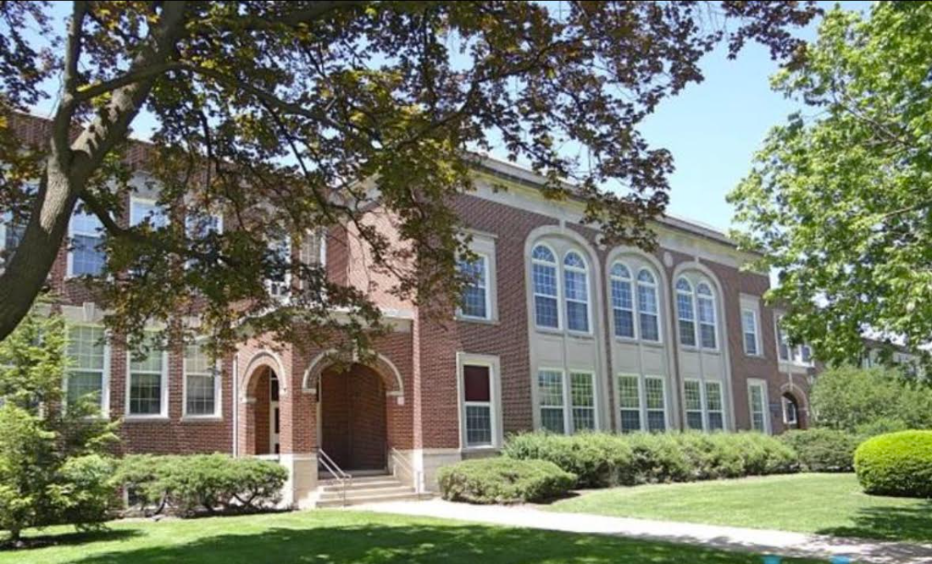
Nomination of Willard School as Local Landmark
Thomas Weber
December 2, 2025

Slide 2
Willard School should be designated a Local Landmark.
Frances E. Willard
Henry Raeder
District 65
Willard in NW Evanston
Childs & Smith
Frances E. Willard
Henry Raeder
District 65
Willard in NW Evanston
Childs & Smith

Slide 3
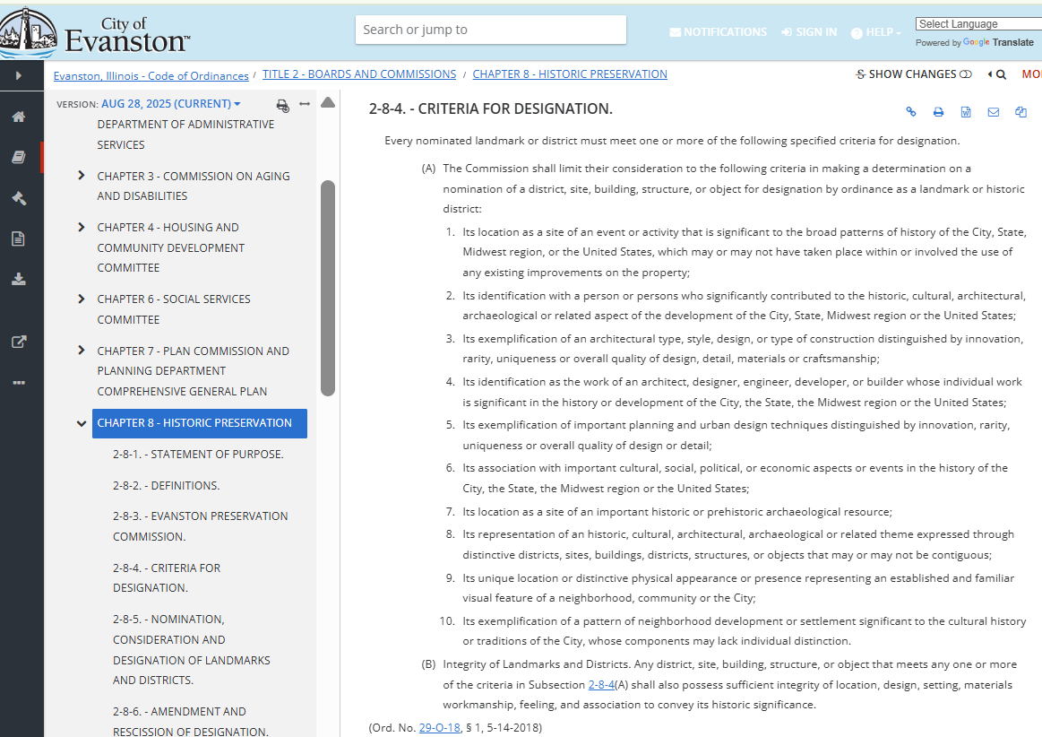
Willard School is identified with Frances E. Willard, who contributed significantly to our history.
Frances E. Willard
Henry Raeder
District 65
Willard in NW Evanston
Childs & Smith

Slide 4
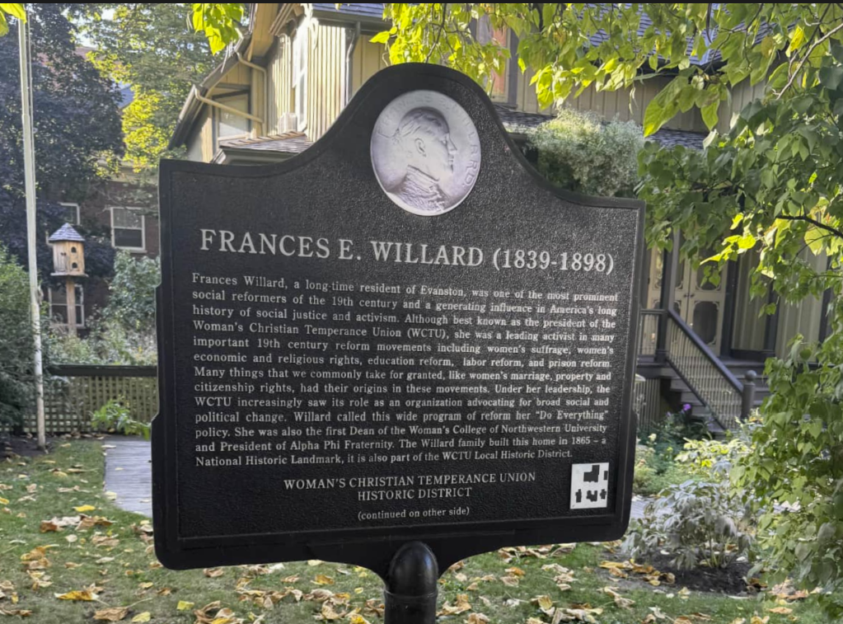
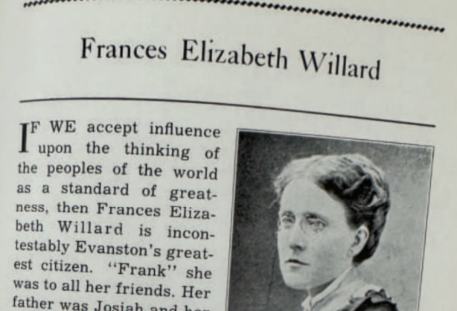
Willard School is identified with Frances E. Willard, who contributed significantly to our history.
Frances E. Willard
Henry Raeder
District 65
Willard in NW Evanston
Childs & Smith

Slide 5
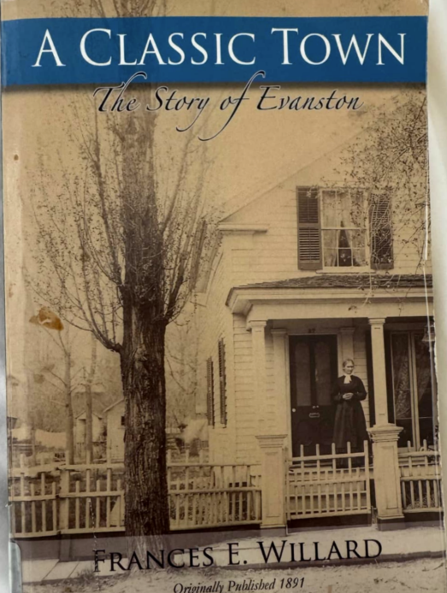
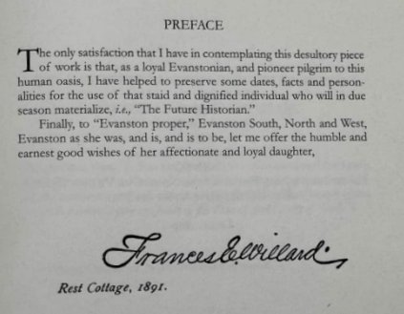
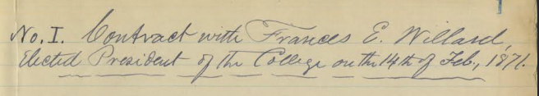
Willard School is identified with Frances E. Willard, who contributed significantly to our history.
Frances E. Willard
Henry Raeder
District 65
Willard in NW Evanston
Childs & Smith

Slide 6

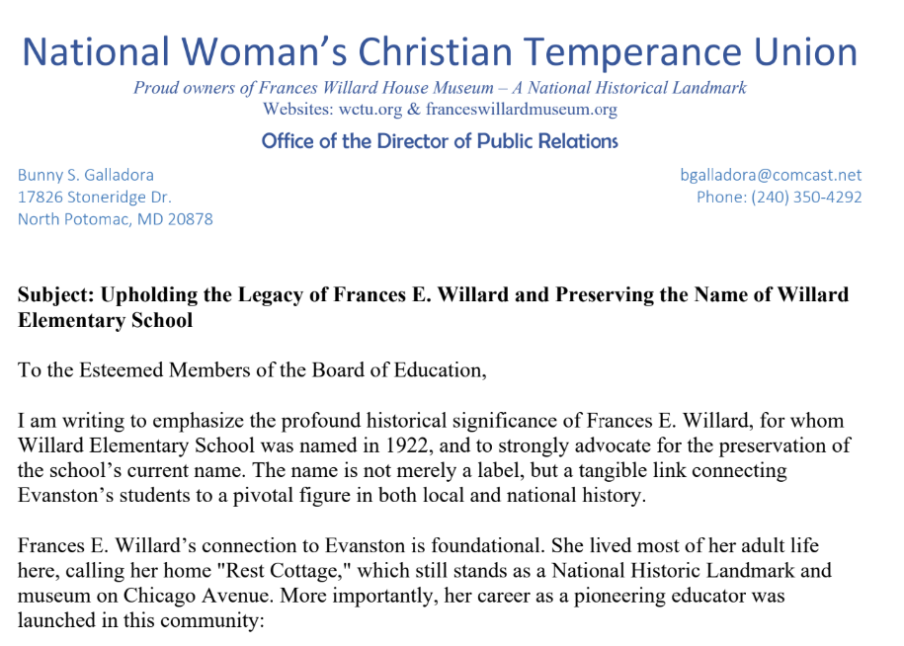
Willard School is identified with Frances E. Willard, who contributed significantly to our history.
Frances E. Willard
Henry Raeder
District 65
Willard in NW Evanston
Childs & Smith

Slide 7
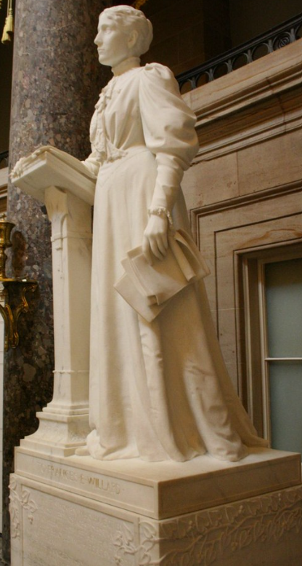
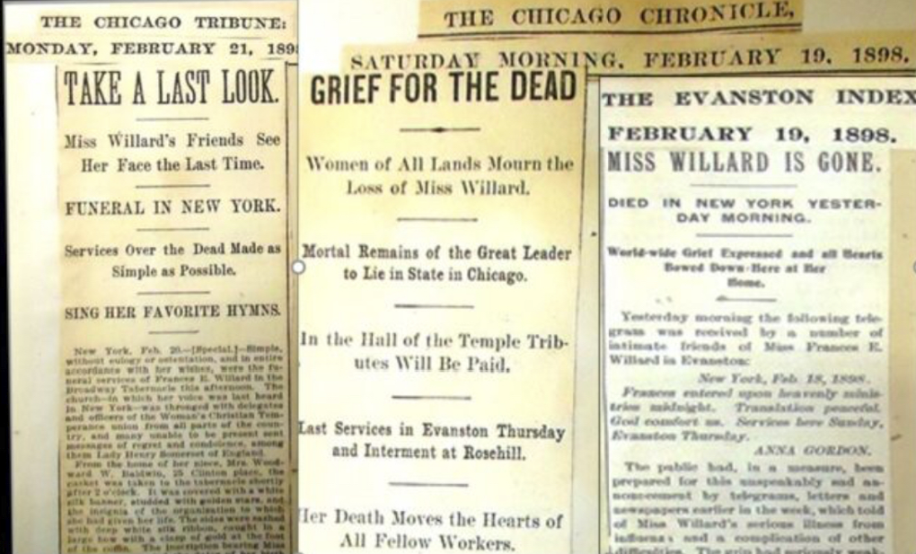
Willard School is identified with Frances E. Willard, who contributed significantly to our history.
Frances E. Willard
Henry Raeder
District 65
Willard in NW Evanston
Childs & Smith

Slide 8
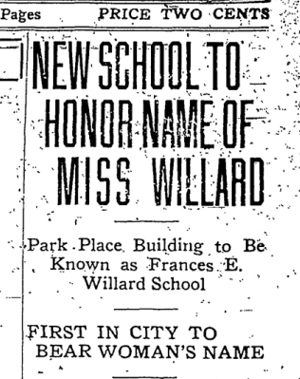
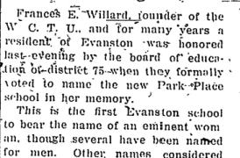
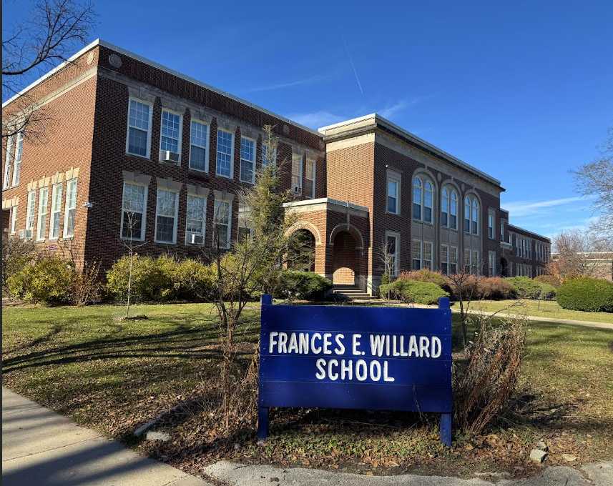
Willard School is identified with Frances E. Willard, who contributed significantly to our history.
Frances E. Willard
Henry Raeder
District 65
Willard in NW Evanston
Childs & Smith

Slide 9
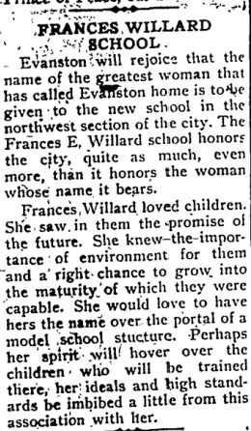
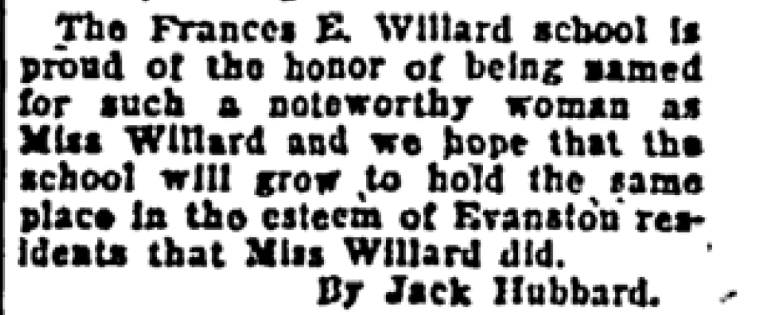
Willard School is identified with Frances E. Willard, who contributed significantly to our history.
Frances E. Willard
Henry Raeder
District 65
Willard in NW Evanston
Childs & Smith

Slide 10
Willard School should be designated a Local Landmark.
Frances E. Willard
Henry Raeder
District 65
Willard in NW Evanston
Childs & Smith

Slide 11



Willard School is identified as the work of Henry Raeder, an architect whose individual work is significant.
Frances E. Willard
Henry Raeder
District 65
Willard in NW Evanston
Childs & Smith

Slide 12
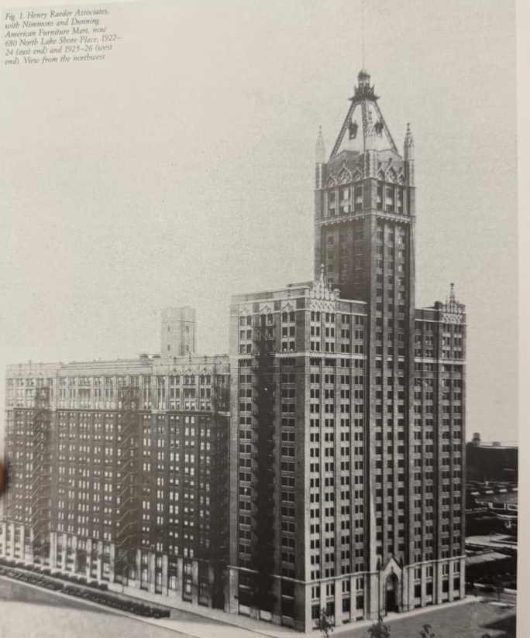
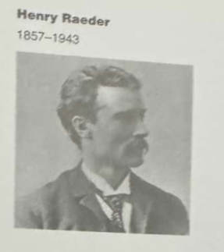
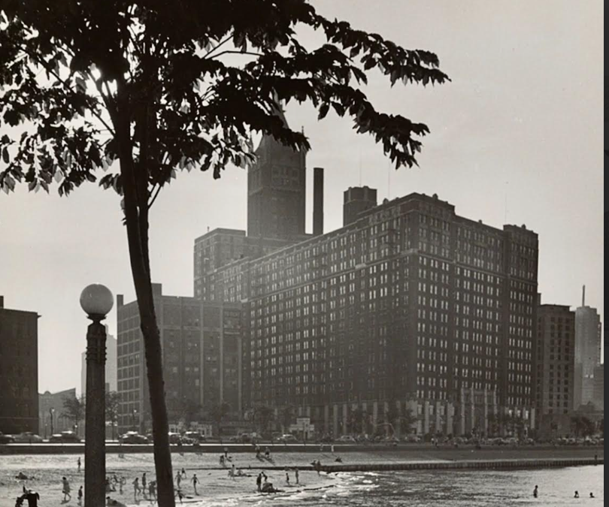
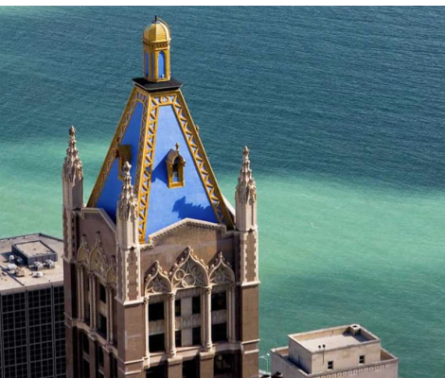
Willard School is identified as the work of Henry Raeder, an architect whose individual work is significant.
Frances E. Willard
Henry Raeder
District 65
Willard in NW Evanston
Childs & Smith

Slide 13
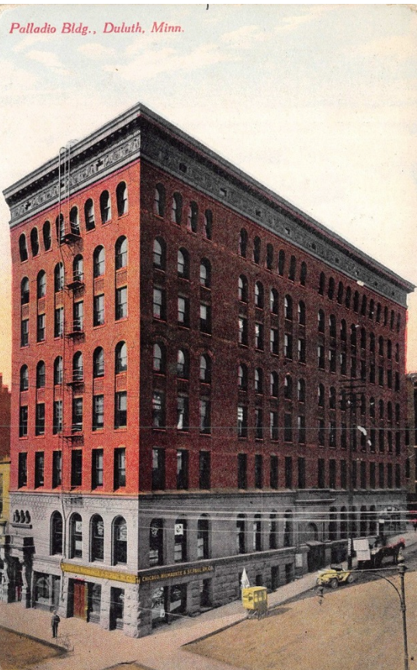
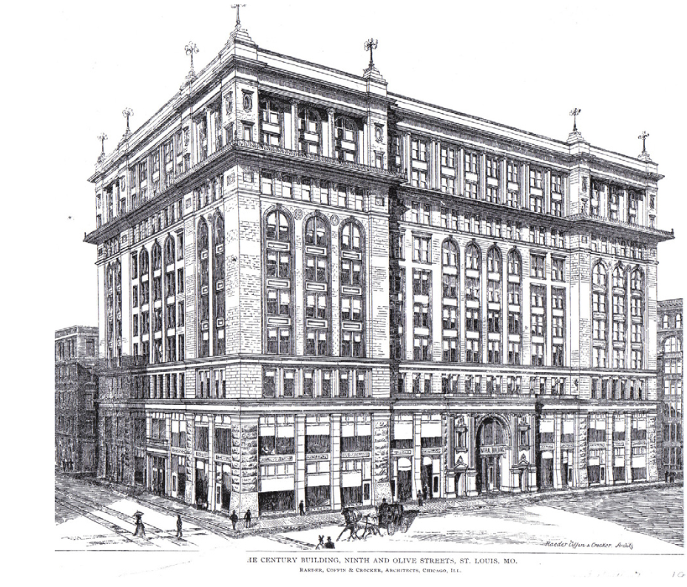
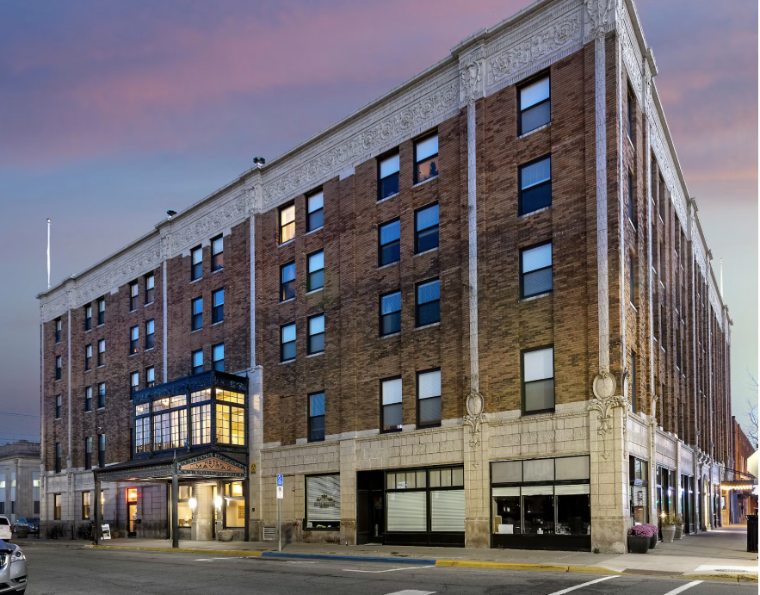
Willard School is identified as the work of Henry Raeder, an architect whose individual work is significant.
Frances E. Willard
Henry Raeder
District 65
Willard in NW Evanston
Childs & Smith

Slide 14
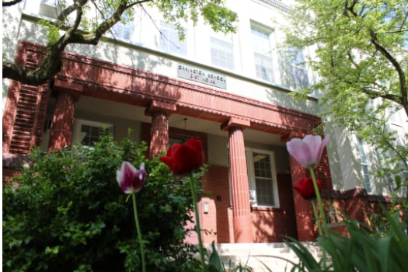
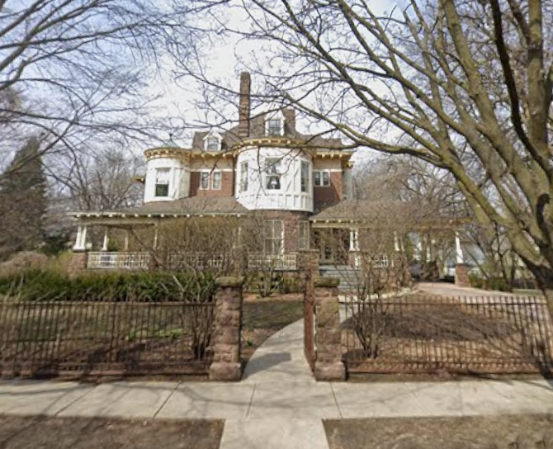
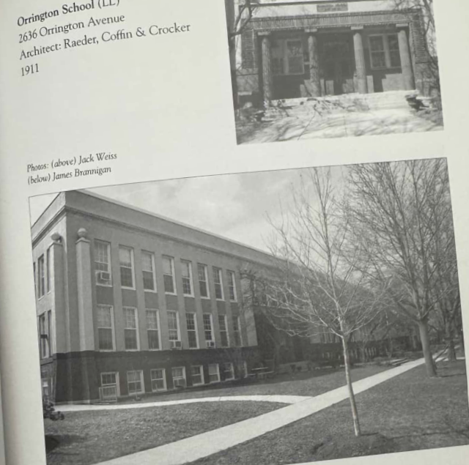
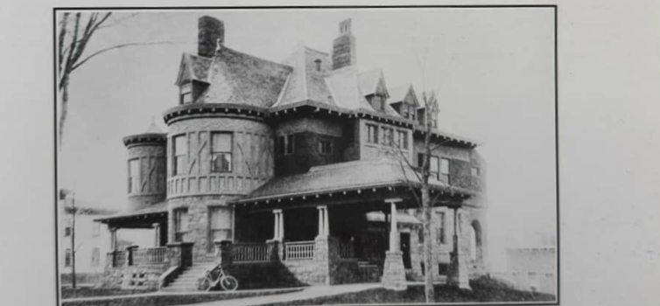
Willard School is identified as the work of Henry Raeder, an architect whose individual work is significant.
Frances E. Willard
Henry Raeder
District 65
Willard in NW Evanston
Childs & Smith

Slide 15
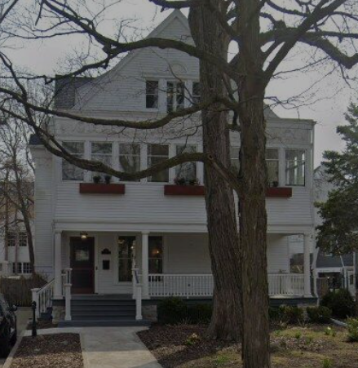
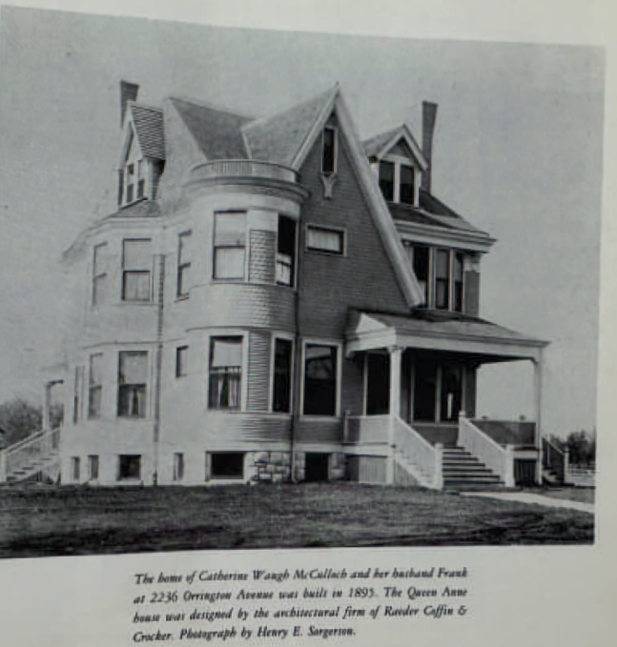
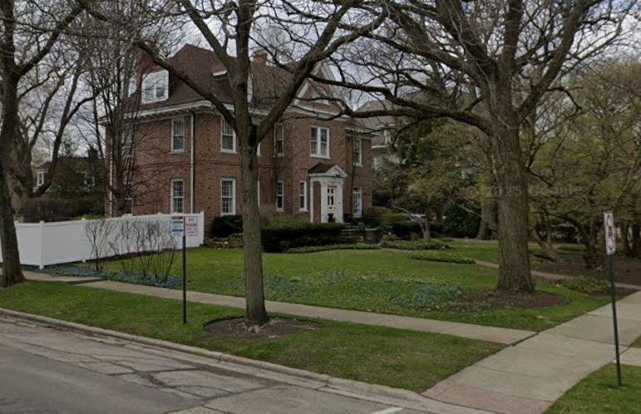
Willard School is identified as the work of Henry Raeder, an architect whose individual work is significant.
Frances E. Willard
Henry Raeder
District 65
Willard in NW Evanston
Childs & Smith

Slide 16
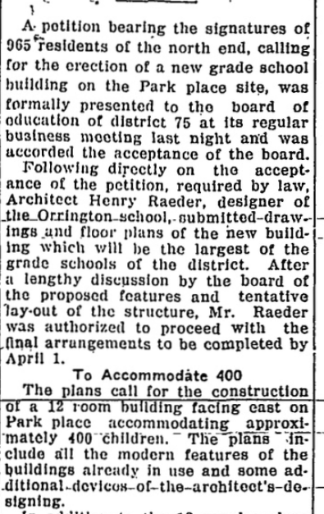
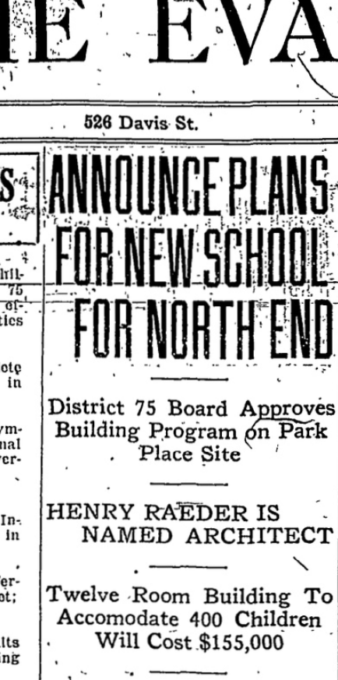
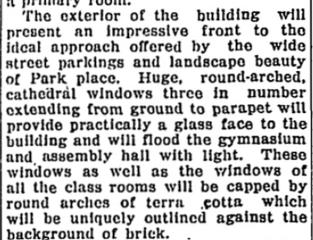
Willard School is identified as the work of Henry Raeder, an architect whose individual work is significant.
Frances E. Willard
Henry Raeder
District 65
Willard in NW Evanston
Childs & Smith

Slide 17
Willard School should be designated a Local Landmark.
Frances E. Willard
Henry Raeder
District 65
Willard in NW Evanston
Childs & Smith

Slide 18
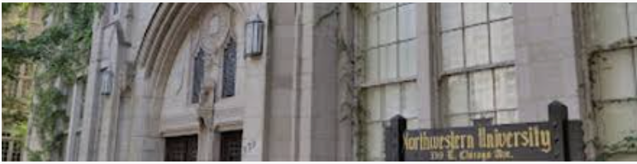
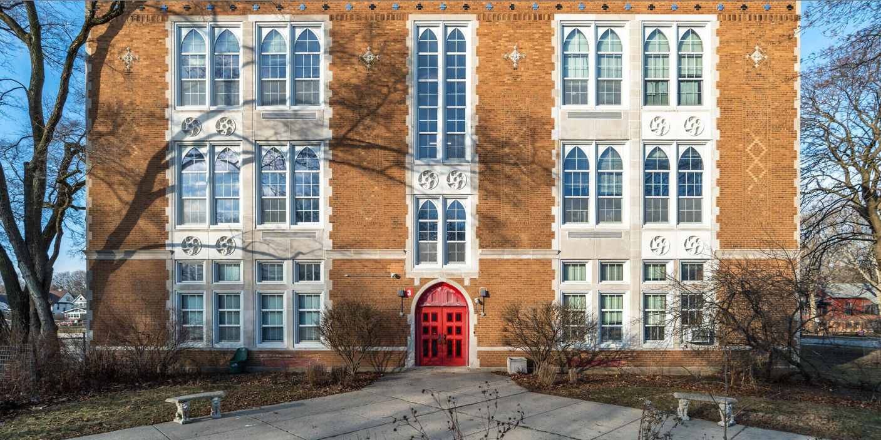
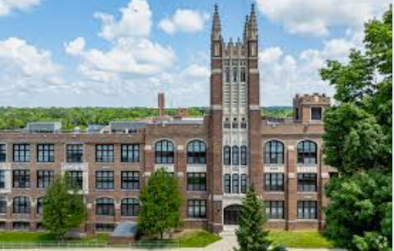
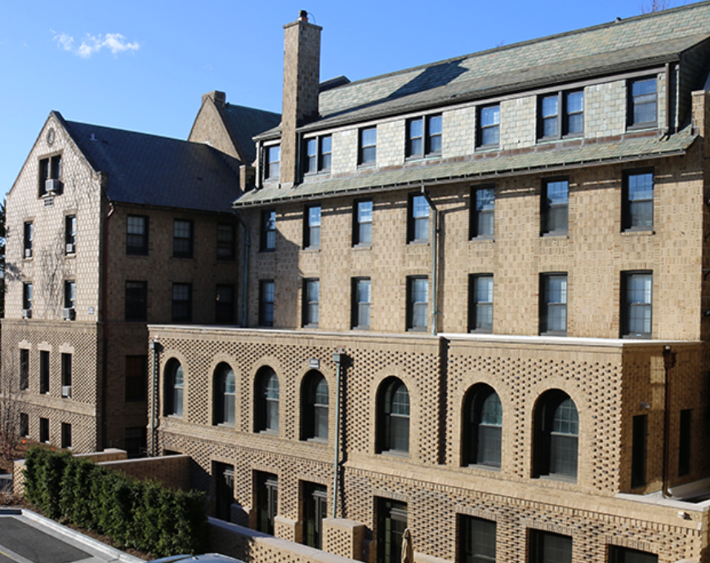
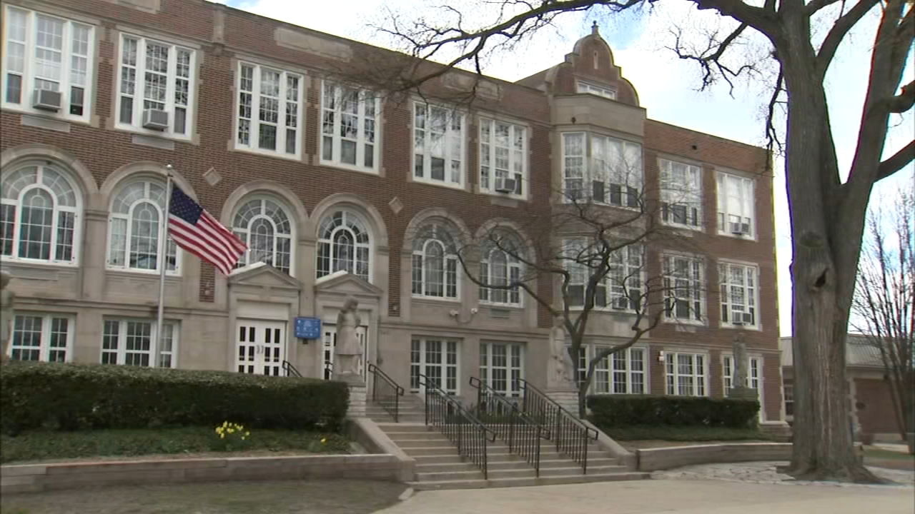
Willard School is identified as the work of Childs & Smith, an architect whose individual work is significant.
Frances E. Willard
Henry Raeder
District 65
Willard in NW Evanston
Childs & Smith

Slide 19
Willard School should be designated a Local Landmark.
Frances E. Willard
Henry Raeder
District 65
Willard in NW Evanston
Childs & Smith

Slide 20


Willard School’s appearance and presence represent an established and familiar feature of Northwest Evanston.
Frances E. Willard
Henry Raeder
District 65
Willard in NW Evanston
Childs & Smith

Slide 21
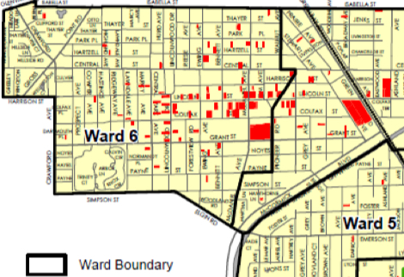
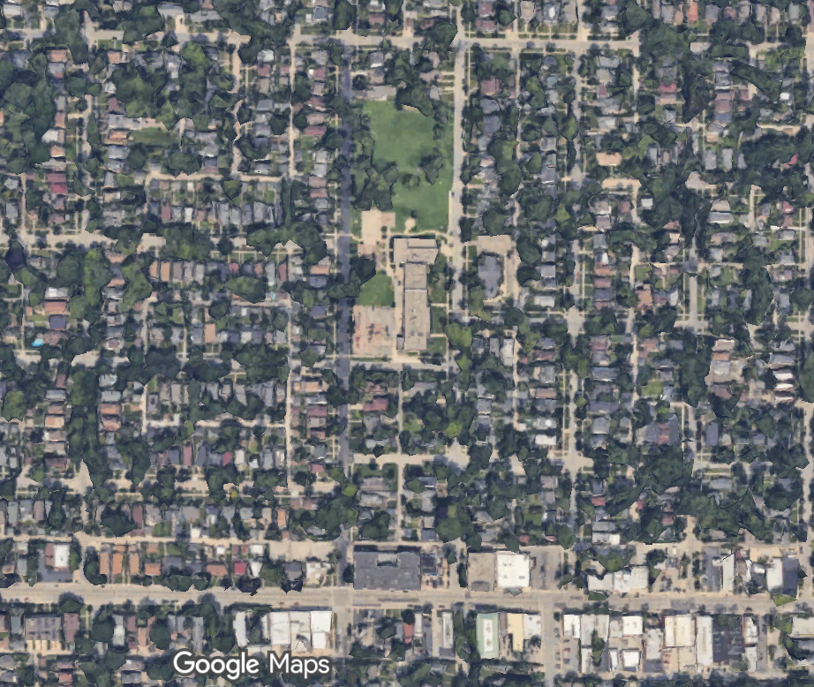
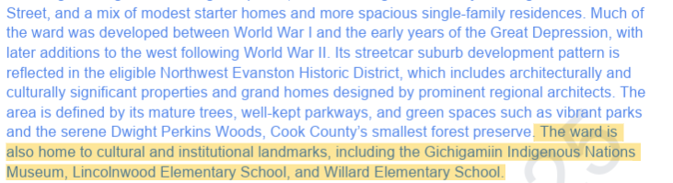
Willard School’s appearance and presence represent an established and familiar feature of Northwest Evanston.
Frances E. Willard
Henry Raeder
District 65
Willard in NW Evanston
Childs & Smith

Slide 22
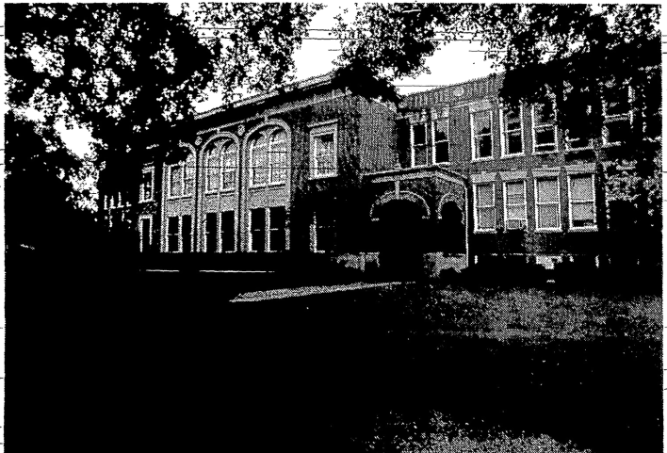
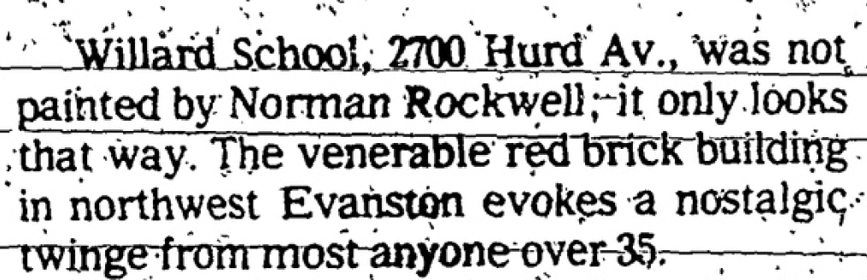
Willard School’s appearance and presence represent an established and familiar feature of Northwest Evanston.
Frances E. Willard
Henry Raeder
District 65
Willard in NW Evanston
Childs & Smith

Slide 23
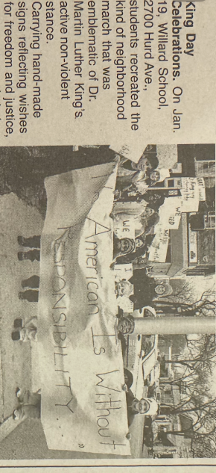
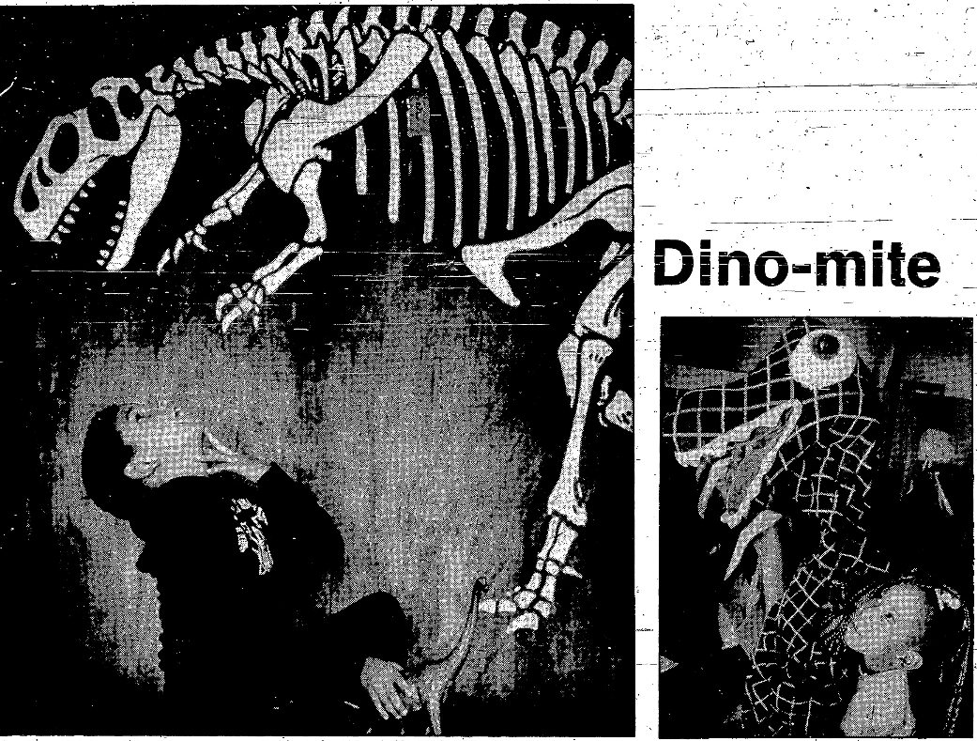
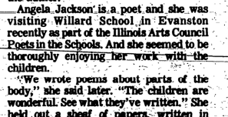
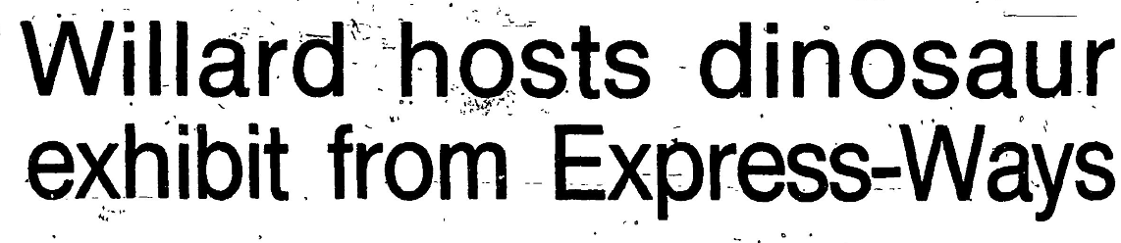
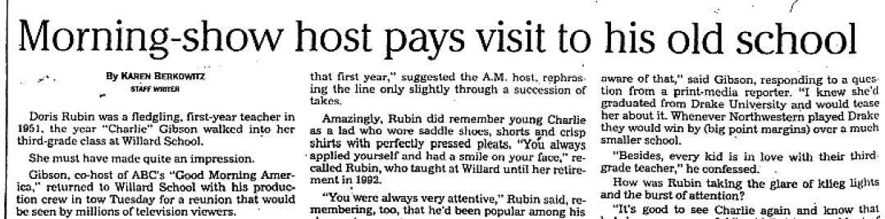
Willard School’s appearance and presence represent an established and familiar feature of Northwest Evanston.
Frances E. Willard
Henry Raeder
District 65
Willard in NW Evanston
Childs & Smith

Slide 24
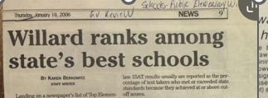
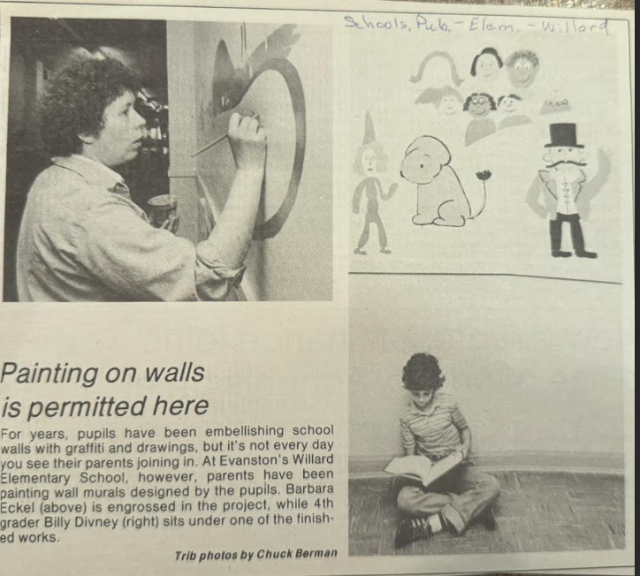
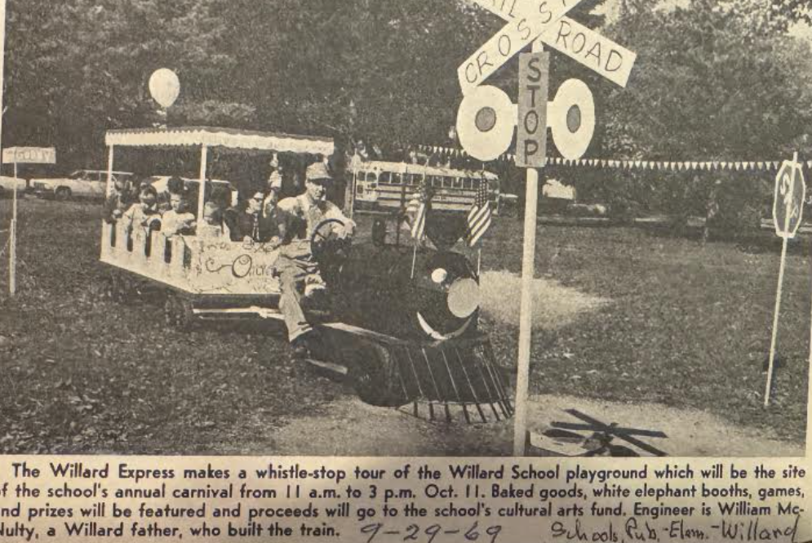

Willard School’s appearance and presence represent an established and familiar feature of Northwest Evanston.
Frances E. Willard
Henry Raeder
District 65
Willard in NW Evanston
Childs & Smith

Slide 25
Willard School should be designated a Local Landmark.
Frances E. Willard
Henry Raeder
District 65
Willard in NW Evanston
Childs & Smith

Slide 26
District 65 faces no burden in Local Landmark designation.
School | Construction Date | Architect
Washington Elem. Sch. | 1901
Orrington Elem. Sch. | 1911 | Raeder; Childs & Smith
Oakton Elem. Sch. | 1914
Evanston Township High Sch. | 1924
Haven Middle Sch. | 1927 | Childs & Smith
Nichols Middle Sch. | 1929 | Childs & Smith
School | Construction Date | Architect
Washington Elem. Sch. | 1901
Orrington Elem. Sch. | 1911 | Raeder; Childs & Smith
Oakton Elem. Sch. | 1914
Willard Elem. Sch. | 1922 | Raeder; Childs & Smith
Evanston Township High Sch. | 1924
Haven Middle Sch. | 1927 | Childs & Smith
Nichols Middle Sch. | 1929 | Childs & Smith
Lincolnwood Elem. Sch. (nominated) | 1949
Frances E. Willard
Henry Raeder
District 65
Willard in NW Evanston
Childs & Smith

Slide 27
Willard School should be designated a Local Landmark.
Frances E. Willard
Henry Raeder
District 65
Willard in NW Evanston
Childs & Smith
Frances E. Willard
Henry Raeder
District 65
Willard in NW Evanston
Childs & Smith
Frances E. Willard
Henry Raeder
District 65
Willard in NW Evanston
Childs & Smith
Frances E. Willard
Henry Raeder
District 65
Willard in NW Evanston
Childs & Smith
Frances E. Willard
Henry Raeder
District 65
Willard in NW Evanston
Childs & Smith
Frances E. Willard
Henry Raeder
District 65
Willard in NW Evanston
Childs & Smith

