Slide 1
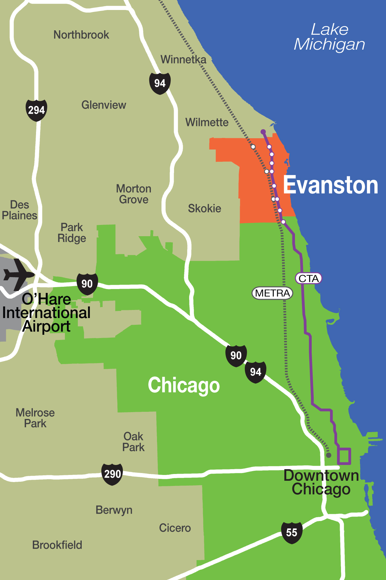
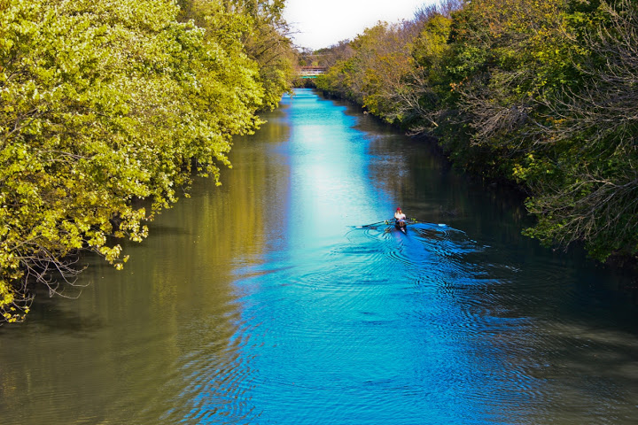
Evanston
2018 Third Quarter Financial Report
Hitesh Desai
Chief Financial Officer/Treasurer
October 22, 2018

Slide 2
2018 THIRD QUARTER overview
General Fund revenues were $91.2M or 79.4% of budget
General Fund expenses were $87.5M or 76.6% of budget
General Fund 2018 Third Quarter ending unreserved fund balance was $16,923,253 with a cash balance of $10,763,842

Slide 3
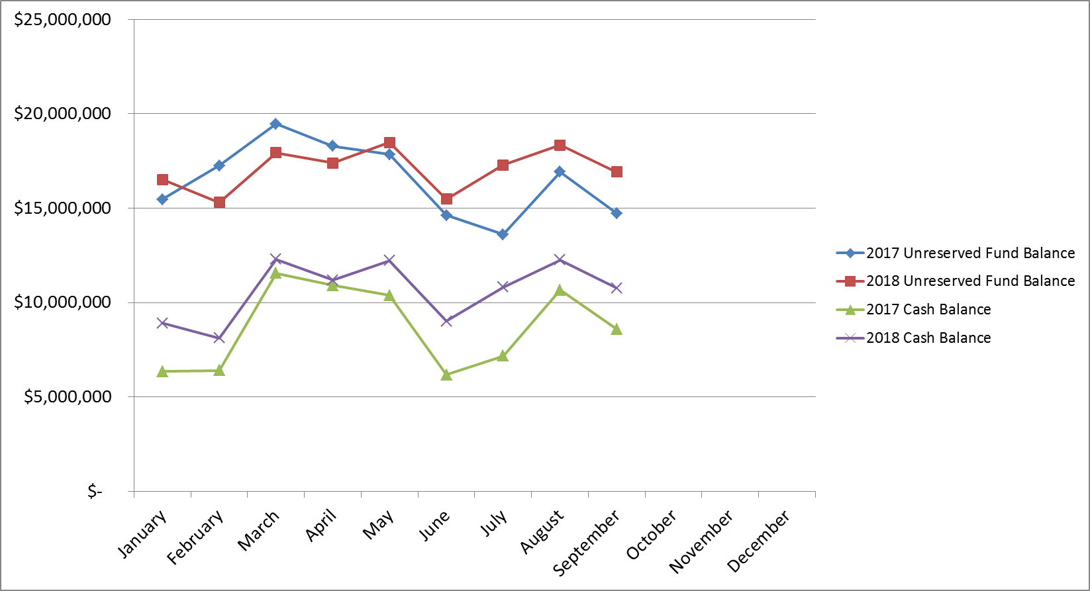
2018 third quarter overview

Slide 4
General fund revenue overview

Slide 5
General fund expense overview
Overall GF expenses are slightly above the 75% target
Police & Fire have expenses associated with the transfer of property tax to pension funds which increases their expenses over the 75% goal
Expenses are not evenly distributed throughout the year (i.e. Parks programs in the summer)

Slide 6
Enterprise fund overview

Slide 7
ALL fundS Revenue overview
All funds are grouped by category/type
Capital budget/Revenue includes Bond Proceeds received in August
Police/Fire Pension revenues are from taxes, contributions and investment income.
Notes:
Overall 79.8%

Slide 8
ALL fundS expense overview
All funds are grouped by category/type
Capital funds do not include expenses for Water/Sewer, etc.
Police/Fire Pension Expenses includes benefits paid.
Notes:
Overall 58.8%

Slide 9
2018 THIRD quarter conclusion
The City of Evanston ended the third quarter in stable financial condition with an operating surplus of $3.7 million .
Enterprise and Capital Funds continue to spend down fund balance on projects and debt service.
Staff will closely monitor revenues and expenses in the last quarter.

Slide 10
QUESTIONS?

