Slide 1



Evanston One-Stop
Housing Retrofit Pilot Program
May 17, 2022

Slide 2
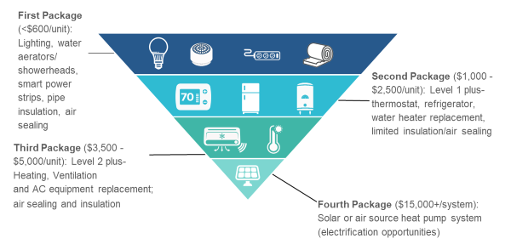
Example Improvement Types
Draft program includes improvements to 50 homes, for total cost of $1 million
Improvements vary by home need, ranging from roughly $6,000 to $35,000
Coordination with other programs – e.g., lead service line removal, or CBDG-eligible rehab – is also planned

Slide 3
Pilot Program Scope of Work
Over the two years of the pilot program:
Program design and communications
Advisory group formation
Outreach, focusing on neighborhoods in Census tracts 8092, 8096, and 8102
Building assessments
Navigate available grants, incentives, and financing
Efficiency upgrades
Contractor support and mentorship
Identify gaps and make program improvements
Evaluate and scale

Slide 4
Organization Roles
CNT will lead engagement with the City and the Advisory Group, coordinate with the third-party evaluator, and prepare the final recommendations for scaling the One Stop Shop.
Elevate will lead building assessments, provide support and quality assurance on retrofits, and contribute to overall program design and final recommendations for scaling the One Stop Shop.
EDC will lead engagement with building owners, provide project management and contractor coordination throughout the retrofit process, and expand their network of minority and woman-owned contractors to provide retrofit services.

Slide 5
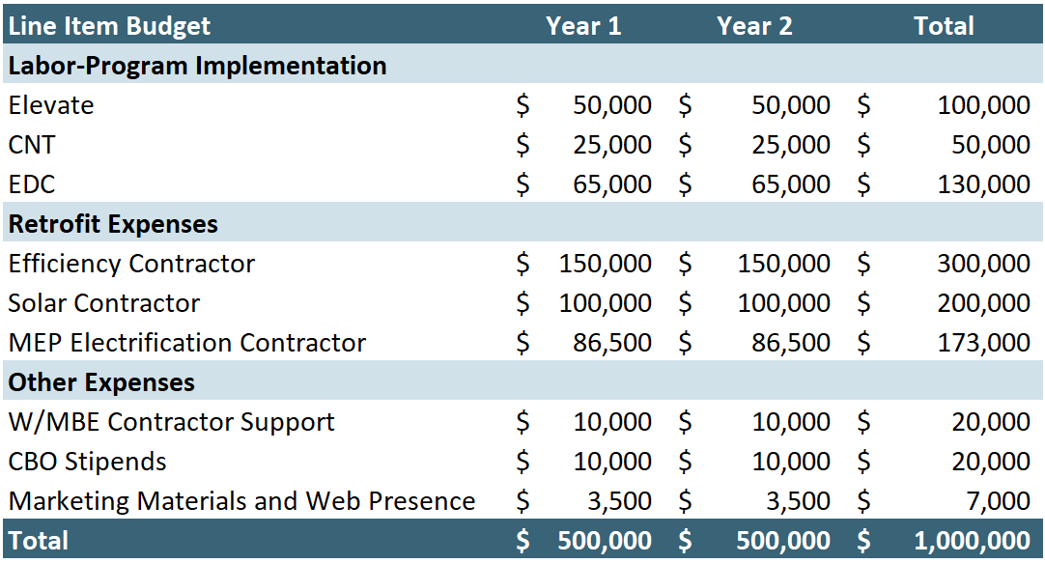
Budget

