Slide 1

Redistricting Committee Update for 2nd Ward Meeting January 24, 2023

Slide 2
Process Overview (see July town hall presentations for more detail)
Notes:
Created by the Rules Committee in December 2021

Slide 3
Redistricting Committee
Melissa Wynne Ward 3
Jonathan Nieuwsma Ward 4 (chair)
Bobby Burns Ward 5
Devon Reid Ward 8
Staff support: City of Evanston Legal Department
Notes:
Created by the Rules Committee in December 2021

Slide 4
State Redistricting Requirements
Are we required to redistrict?
Only if our population falls below 70,000 or grows above 90,000
65 ILCS 5/3.1-20-10, 65 ILCS 5/3.1-20-25(b)
But can we redistrict?
Yes, we can redistrict “for any other reason”
65 ILCS 5/3.1-20-25(c)
If we do redistrict:
“…wards shall be as nearly equal in population, and the wards shall be of as compact and contiguous territory, as practicable.”
65 ILCS 5/3.1-20-10, 65 ILCS 5/3.1-20-25(a)
Notes:
State Law is in the Illinois Municipal Code

Slide 5
Federal Redistricting Requirements
US Constitution: Equal Protection Clause of the 14th Amendment
Voting Rights Act of 1965
Case Law
How equal is equal?
Total deviation from ideal district size (total population divided by # of districts)
<10% regarded as “one person, one vote” compliant
10-16.4% can be acceptable if justified based on legitimate considerations
>16.4% regarded as unconstitutional per 14th amendment
White v. Regester, 412 U.S. 755, 764 (1973); Brown v. Thomson, 462 U.S. at 842-43. 9
Mahan v. Howell, 410 U.S. 315, 325 (1973).
Connor v. Finch, 413 U.S. 407, 420 (1977). But see Brown v. Thomson, and Gorin v. Karpan, 775 F.Supp. 1430 (D.Wyo. 1991).
Notes:
14th amendment: one person, one vote
Voting rights act: minority representation—Section 2 prohibits denial or abridgement of the right to vote based on race, color, minority status., language…

Slide 6
Should we redistrict: State Law?
79,808 | 73,706 | 73,233 | 74,239 | 74,486 | 78,110
+0.7% | -7.6% | -0.6% | +1.4% | +0.3% | +4.9%
Notes:
Our population is fairly steady—still between 70,000 and 90,000
So state law does not require redistricting

Slide 7
Should we redistrict: Voting Rights Act?
Notes:
Ward demographics have changed, but we still have three “majority non-white” wards (2,5,8)
All wards except Ward 1 have increased in total population
Ward 2 has grown the most, followed closely by Ward 3
Overall: +4.9%
Black: -6.9%
White: -5.6%
Asian: +21%

Slide 8
Should we redistrict: Voting Rights Act?
Notes:
Hispanic/Latino population up in all wards.
Overall: Up 30%.
By numbers: Ward 4 and Ward 8 grew the most (about 400 each)
By percent: Ward 3 grew the most (61%)

Slide 9
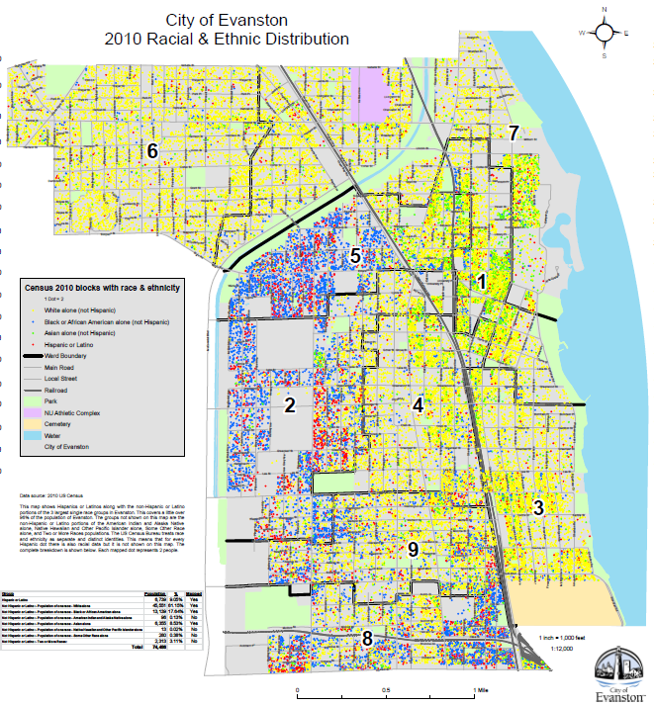
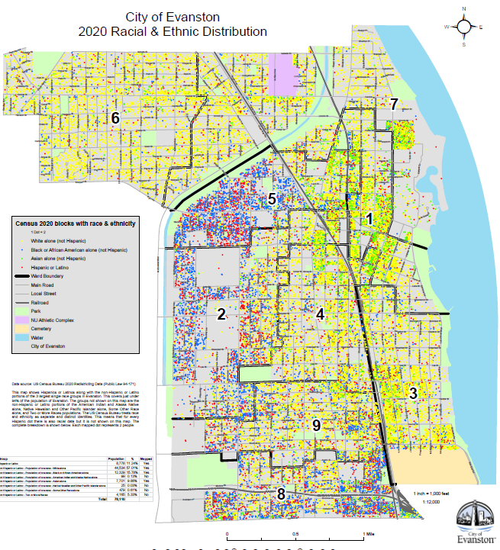
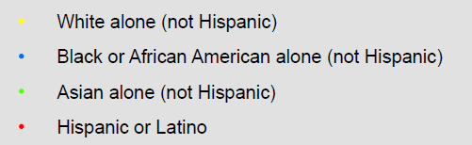
Should we redistrict: Voting Rights Act?
2010
2020
Notes:
Ward demographics have changed, but we still have three “majority non-white” wards (2,5,8)
All wards except Ward 1 have increased in total population
Ward 2 has grown the most, followed closely by Ward 3
Overall: +4.9%
Black: -6.9%
White: -5.6%
Asian: +21%

Slide 10
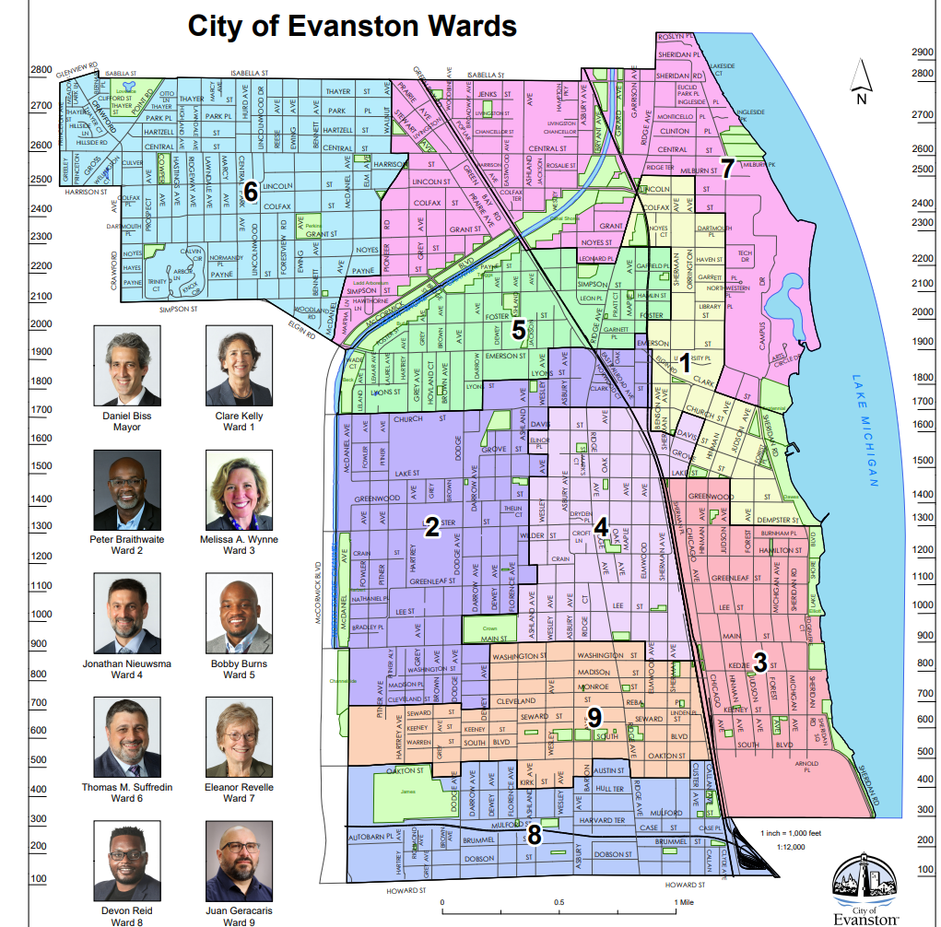
Should we redistrict: Equal Representation?
2020 Census Data
+4.2%
 |  | ----Deviation-----
Ward | Population | +/- from avg. | as % of avg.
1 | 8,088 | -591 | -6.8%
2 | 9,111 | 432 | 5.0%
3 | 9,691 | 1,012 | 11.7%
4 | 8,473 | -206 | -2.4%
5 | 7,974 | -705 | -8.1%
6 | 8,961 | 282 | 3.3%
7 | 9,047 | 368 | 4.2%
8 | 8,845 | 166 | 1.9%
9 | 7,920 | -759 | -8.7%
Total | 78,110
Average | 8,679 | per ward
Total Population Deviation: |  |  | 20.4%
+3.3%
-8.1%
-6.8%
+5.0%
-2.4%
8.7 + 11.7 = 20.4
+11.7%
YES!
-8.7%
+1.9%
Notes:
Our population is fairly steady—state law doesn’t require it.
But our ward populations are pretty out of balance –federal guidance indicates that we should.
What do YOU think?
REAL TIME SURVEY HERE: Should we redistrict?

Slide 11
Evanston Redistricting Requirements
Evanston City Code specifies 9 wards but offers no additional guidance
Past Practice: take additional criteria into account
From 2003: (Ordinance 103-O-03):
US Constitution (14th amendment equal protection clause)
Voting rights act
Compactness
Contiguity
Natural geographic boundaries
Manmade geographic boundaries
Minimization of voter confusion
Communities of interest (residential property owners, municipal taxpayers, lakefront property owners, commercial business interests, student population)
Traditional Evanston neighborhoods
Protection of incumbency
federal
state
local
Notes:
Moving forward: additional input on criteria to consider, including identifying communities of interest

Slide 12
Moving Forward: The 2022 Process
Responsibility assigned to a special Redistricting Committee
Meetings: 4th Tuesday of every month
Committee findings to date:
Confirmed intent to redistrict
Confirmed importance of having at least three majority non-white wards
Confirmed desire to have multiple councilmembers represent downtown
Decided to pursue an incremental approach
Developed community engagement plan
We have NOT formally considered a new map—public input first!
Committee webpage:
https://www.cityofevanston.org/government/boards-commissions-and-committees/redistricting-committee
Notes:
I hope we can get through this with minimal conflict and drama:
*deliberate and logical approach
*proactive engagement
Redistricting Committee was appointed in December 2021: Wynne, Reid, Burns, Nieuwsma
Have met twice so far: May and June 2022

Slide 13
Overall Plan
Kickoff Town Halls July 2022
Coordinated public engagement at committee meetings July 2022 through January 2023
Committee drafts several maps January 2023
Committee releases proposed map(s) February 2023
Public comment on proposed map(s) February to April 2023
Final committee meeting: recommend new map April 2023
Council approval May 2023
Deadline:
“Redistricting shall be completed not less than 30 days before the first day for filing candidate petitions under the general election law for the next succeeding election of city officers”
65 ILCS 5/3.1-20-25
i.e. mid November 2024 for the 2025 primary consolidated election
The new ward map will take effect starting with the 2025 election.
Notes:
This is the overall plan—more about the 5 months for community engagement on the next slide.
Timeline: cannot complete this process before the April 2023 special election in Wards 2 & 9
To be clear, the new ward map would not take effect until the regular 2025 election.
*we’ll vote in the new wards in April 2025 and be represented by those councilmembers when the new council takes office in May 2025
*we will be represented by current councilmembers in our current wards until then (May 2025).

Slide 14
Public Engagement Schedule
Redistricting Committee meetings will be the primary venue for engagement
Fourth Tuesdays, (usually) 7:00 pm, Civic Center, in person + virtual
Input requested on redistricting criteria and ward boundaries
Will focus on specific wards per this schedule:
Date Wards
August 23 2, 4
October 25 6, 7
November 22 8, 9
January 10 1, 3
January 26 5
Sign up here: Public Comment Sign-Up | City of Evanston
Notes:
Community input is critical!!!
Input requested:
what criteria to consider
Where to draw the lines
The schedule is almost numeric, some changes to balance “level of difficulty”
Please sign up using the link. We REQUEST that you attend the session scheduled for your ward, but this is not required.

Slide 15
WARD 2

Slide 16
Ward 2
2020 Census Data
 |  | ----Deviation-----
Ward | Population | +/- from avg. | as % of avg.
1 | 8,088 | -591 | -6.8%
2 | 9,111 | 432 | 5.0%
3 | 9,691 | 1,012 | 11.7%
4 | 8,473 | -206 | -2.4%
5 | 7,974 | -705 | -8.1%
6 | 8,961 | 282 | 3.3%
7 | 9,047 | 368 | 4.2%
8 | 8,845 | 166 | 1.9%
9 | 7,920 | -759 | -8.7%
Total | 78,110
Average | 8,679 | per ward
Total Population Deviation: |  |  | 20.4%
+4.2%
+3.3%
-8.1%
-6.8%
8.7 + 11.7 = 20.4
Ward 2 is oversized by 432 (+5.0%).
Bordering Wards:
Ward 1 -591
Ward 4 -206
Ward 5 -705
Ward 9 -759
+5.0%
-2.4%
+11.7%
-8.7%
+1.9%

Slide 17
Ward 2 Demographics
Ward 2 Population Shift
Year | Pop. | +/- from avg. | as % | White | Black | Native American | Asian | Hawaii/Pacific Islander | Other | Two or More | Hispanic/Latino
2010 | 8,133 | -143 | -1.7% | 3,204 | 3,210 | 44 | 522 | 0 | 765 | 388 | 1,503
2020 | 9,111 | 432 | 5.0% | 3,795 | 2,499 | 121 | 797 | 2 | 698 | 1,199 | 1,681
Change | 978 |  |  | 591 | -711 | 77 | 275 | 2 | -67 | 811 | 178
Year | Pop. | +/- from avg. | as % | White | Black | Native American | Asian | Hawaii/Pacific Islander | Other | Two or More | Hispanic/Latino
2010 |  |  |  | 39% | 39% | 1% | 6% | 0% | 9% | 5% | 18%
2020 |  |  |  | 42% | 27% | 1% | 9% | 0% | 8% | 13% | 18%

Slide 18
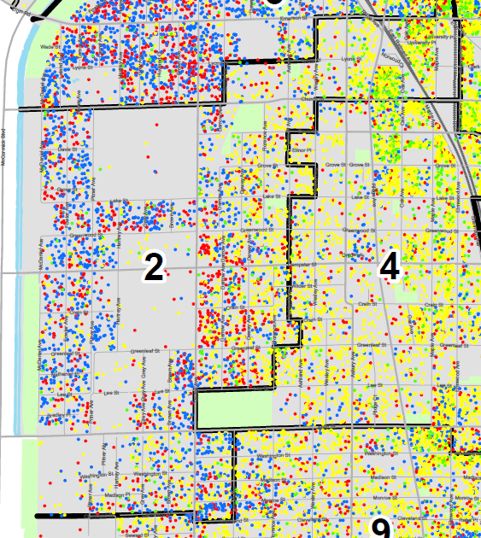
Ward 2 Racial/Ethnic Distribution

Slide 19
Ward 2 is oversized by 432 (+5.0%).
Bordering Wards:
Ward 1 -591
Ward 4 -206
Ward 5 -705
Ward 9 -759
-591
-705
How can we make Ward 2 smaller?
+432
-206
-759

Slide 20
BACKUP DATA

Slide 21
2010 CENSUS DATA
 |  | ----Deviation-----
Ward | Population | +/- from avg. | as % of avg. | White | Black | Native American | Asian | Hawaii/Pacific Islander | Other | Two or More | Hispanic/Latino
1 | 8,252 | -24 | -0.3% | 5,784 | 411 | 7 | 1,733 | 3 | 79 | 235 | 432
2 | 8,133 | -143 | -1.7% | 3,204 | 3,210 | 44 | 522 | - | 765 | 388 | 1,503
3 | 8,742 | 466 | 5.6% | 7,124 | 508 | 20 | 659 | 4 | 96 | 331 | 443
4 | 8,075 | -201 | -2.4% | 6,148 | 702 | 19 | 786 | 1 | 120 | 299 | 467
5 | 7,778 | -498 | -6.0% | 2,981 | 3,231 | 27 | 686 | - | 507 | 346 | 1,117
6 | 8,952 | 676 | 8.2% | 8,157 | 212 | 10 | 299 | 1 | 58 | 215 | 249
7 | 8,702 | 426 | 5.1% | 7,131 | 332 | 4 | 889 | 3 | 78 | 265 | 393
8 | 8,250 | -26 | -0.3% | 3,448 | 3,259 | 25 | 443 | - | 659 | 416 | 1,302
9 | 7,602 | -674 | -8.2% | 4,895 | 1,609 | 19 | 399 | 4 | 325 | 351 | 833
Total | 74,486 |  |  | 48,872 | 13,474 | 175 | 6,416 | 16 | 2,687 | 2,846 | 6,739
Average | 8,276 |  |  | 66% | 18% | 0.2% | 9% | 0.0% | 4% | 4% | 9%
Total Population Deviation: |  |  | 16.3%

Slide 22
2020 Census Data
 |  | ----Deviation-----
Ward | Population | +/- from avg. | as % of avg. | White | Black | Native American | Asian | Hawaii/Pacific Islander | Other | Two or More | Hispanic/ Latino
1 | 8,088 | -591 | -6.8% | 5,117 | 498 | 8 | 1,701 | 5 | 210 | 549 | 560
2 | 9,111 | 432 | 5.0% | 3,795 | 2,499 | 121 | 797 | 2 | 698 | 1,199 | 1681
3 | 9,691 | 1,012 | 11.7% | 7,040 | 624 | 48 | 905 | 2 | 213 | 859 | 713
4 | 8,473 | -206 | -2.4% | 5,578 | 775 | 27 | 1,146 | 8 | 188 | 751 | 652
5 | 7,974 | -705 | -8.1% | 2,577 | 2,900 | 71 | 802 | 8 | 740 | 876 | 1520
6 | 8,961 | 282 | 3.3% | 7,605 | 286 | 11 | 315 | 2 | 71 | 671 | 367
7 | 9,047 | 368 | 4.2% | 6,661 | 423 | 15 | 1,015 | 7 | 153 | 773 | 578
8 | 8,845 | 166 | 1.9% | 3,057 | 3,157 | 139 | 588 | 6 | 841 | 1,057 | 1688
9 | 7,920 | -759 | -8.7% | 4,703 | 1,380 | 83 | 482 | 3 | 368 | 901 | 1019
Total | 78,110 |  |  | 46,133 | 12,542 | 523 | 7,751 | 43 | 3,482 | 7,636 | 8,778
Average | 8,679 | per ward |  | 59% | 16% | 0.7% | 10% | 0.1% | 4% | 10% | 11%
Total Population Deviation: |  |  | 20.4%

Slide 23
2010 to 2020 Change
 |  | ----Deviation-----
Ward | Population | +/- from avg. | as % of avg. | White | Black | Native American | Asian | Hawaii/Pacific Islander | Other | Two or More | Hispanic/ Latino
1 | -164 |  |  | -667 | 87 | 1 | -32 | 2 | 131 | 314 | 128
2 | 978 |  |  | 591 | -711 | 77 | 275 | 2 | -67 | 811 | 178
3 | 949 |  |  | -84 | 116 | 28 | 246 | -2 | 117 | 528 | 270
4 | 398 |  |  | -570 | 73 | 8 | 360 | 7 | 68 | 452 | 185
5 | 196 |  |  | -404 | -331 | 44 | 116 | 8 | 233 | 530 | 403
6 | 9 |  |  | -552 | 74 | 1 | 16 | 1 | 13 | 456 | 118
7 | 345 |  |  | -470 | 91 | 11 | 126 | 4 | 75 | 508 | 185
8 | 595 |  |  | -391 | -102 | 114 | 145 | 6 | 182 | 641 | 386
9 | 318 |  |  | -192 | -229 | 64 | 83 | -1 | 43 | 550 | 186
Total | 3,624 |  |  | -2,739 | -932 | 348 | 1,335 | 27 | 795 | 4,790 | 2,039
Average | 403 | per ward
Ward | Population | +/- from avg. | as % of avg. | White | Black | Native American | Asian | Hawaii/Pacific Islander | Other | Two or More | Hispanic/Latino
1 | -2.0% |  |  | -11.5% | 21.2% | 14.3% | -1.8% | 66.7% | 165.8% | 133.6% | 29.6%
2 | 12.0% |  |  | 18.4% | -22.1% | 175.0% | 52.7% | #DIV/0! | -8.8% | 209.0% | 11.8%
3 | 10.9% |  |  | -1.2% | 22.8% | 140.0% | 37.3% | -50.0% | 121.9% | 159.5% | 60.9%
4 | 4.9% |  |  | -9.3% | 10.4% | 42.1% | 45.8% | 700.0% | 56.7% | 151.2% | 39.6%
5 | 2.5% |  |  | -13.6% | -10.2% | 163.0% | 16.9% | #DIV/0! | 46.0% | 153.2% | 36.1%
6 | 0.1% |  |  | -6.8% | 34.9% | 10.0% | 5.4% | 100.0% | 22.4% | 212.1% | 47.4%
7 | 4.0% |  |  | -6.6% | 27.4% | 275.0% | 14.2% | 133.3% | 96.2% | 191.7% | 47.1%
8 | 7.2% |  |  | -11.3% | -3.1% | 456.0% | 32.7% | #DIV/0! | 27.6% | 154.1% | 29.6%
9 | 4.2% |  |  | -3.9% | -14.2% | 336.8% | 20.8% | -25.0% | 13.2% | 156.7% | 22.3%
Total | 4.9% |  |  | -5.6% | -6.9% | 198.9% | 20.8% | 168.8% | 29.6% | 168.3% | 30.3%

